Slide 1

Welcome to the Riot API Bootcamp!
Know more, win more.

Slide 2








What is the purpose of this course?
Learning to use the Riot API is a bit of a struggle. There's very few resources out there and they're not very structured.
“The Riot API Bootcamp Course is designed to take you from no knowledge up to building your own app.”

Slide 3




Who am i?
Karl, Rocket Scientist & Data Analyst
Past work and collaborations:
Cloud 9
NASA
Wells Fargo
Mozilla
Lockheed Martin
Air Force Research Lab
Siemens, GSK
Experience in everything from AI/ML to jet engine design
“Solve difficult problems with novel methods, by any means necessary”
RebirthNA#2359
@LoL-Genius
417devops@gmail.com

Slide 4
Bootcamp syllabus
Basics (Python, GitHub, Notepad++)
Resources to get started
Setting up an environment
Downloading GitHub repos
JSON explanation & Notepad++ example
Project: read csv file, convert to data frame, create graphs
Riot API introduction
What is an API?
Getting access & Registering your App
What end points are there/what data is available?
Explanation of puuid/account name
Project: make an API call on the website & download the data
Automating API interactions
Introduction to libraries (Cassiopeia, Riot Watcher)
Getting help (documentation, Discord)
Project: automate an API call using a library
Single Endpoint Data
Use case explanation (e.g., in-depth match analysis, leaderboards)
Code example- getting challenger leaderboard
Project: request last 25 games for an account and determine the most common champion(s)
Large Scale Data Collection
Use case explanation (e.g., match history of top 50 players)
Setting up a process pipeline
Comparing 1 file approach vs. functions across files approach
Project: determine number of roles (TOP, MID, etc) on the challenger ladder using the last 5 games
5 Modules covering core topics Project at the end of each

Slide 5
Bootcamp syllabus
Basics (Python, GitHub, Notepad++)
Resources to get started
Setting up an environment
Downloading GitHub repos
JSON explanation & Notepad++ example
Project: read csv file, convert to data frame, create graphs
Riot API introduction
What is an API?
Getting access & Registering your App
What end points are there/what data is available?
Explanation of puuid/account name
Project: make an API call on the website & download the data
Automating API interactions
Introduction to libraries (Cassiopeia, Riot Watcher)
Getting help (documentation, Discord)
Project: automate an API call using a library
Single Endpoint Data
Use case explanation (e.g., in-depth match analysis, leaderboards)
Code example- getting challenger leaderboard
Project: request last 25 games for an account and determine the most common champion(s)
Large Scale Data Collection
Use case explanation (e.g., match history of top 50 players)
Setting up a process pipeline
Comparing 1 file approach vs. functions across files approach
Project: determine number of roles (TOP, MID, etc) on the challenger ladder using the last 5 games
5 Modules covering core topics Project at the end of each

Slide 6

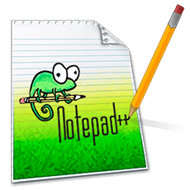

GitHub Desktop Video
Walkthrough of features
Downloading
Cloning a Repo
Pushing a commit

Slide 7
Module 1: Basics
Riot API BOOTCAMP
Slide Deck

Slide 8

Module 1: Basics
Basics (Python, GitHub, Notepad++)
Resources to get started
Setting up an environment
Downloading GitHub repos
JSON explanation & Notepad++ example
Project: read csv file, convert to data frame, create graphs
Let’s Dive In

Slide 9

Resources to get started
Python (Programming Language)
Applications
Python is a programming language
A way of translating language into computer code
Free, distributed by the Python Foundation: https://www.python.org/about/gettingstarted/
This is not a Python course
I expect you know basic programming concepts
Example: I will explain what a for loop does, but not the syntax behind it
There are plenty of Python guides out there!
Better explainers than I can make
Python Foundation even has a getting started guide: https://wiki.python.org/moin/BeginnersGuide
Anaconda Navigator
Python IDE + package manager
Download at: https://www.anaconda.com/products/individual
Guide: https://docs.anaconda.com/anaconda/navigator/index.html
GitHub
Version control and collaborative coding
Web version at https://github.com/
Download the desktop app: https://desktop.github.com/
Guide to getting started: https://www.freecodecamp.org/news/the-beginners-guide-to-git-github/
Notepad++
Text editor, useful for reading data files
Download at: https://notepad-plus-plus.org/
Very useful plug-in, “JS Tool” https://www.sunjw.us/jstool/npp/
These are not the only programs out there- only what I use!
Just about everything is free & open source, so there is a lot of help on the internet (check Stack Overflow!)

Slide 10
Anaconda Navigator Video
Walkthrough of features
Spyder
Making an environment
Package Manager
Anaconda prompt

Slide 11
Notepad++ Video
Walkthrough of features
Programming Language selection
Adding Plug-ins
JSON example

Slide 12
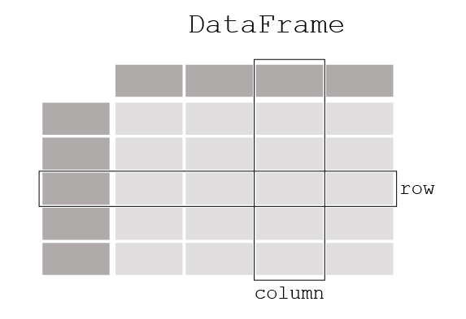
First Steps
Let’s build our first Python script!
Goal: familiarity with Python, Spyder IDE, Pandas package
Open the Python IDE
Open Anaconda Navigator
Click Spyder
Update the file information
Purpose of the file & last update
Save the file!
Import Pandas
import pandas
https://pandas.pydata.org/docs/getting_started/index.html
Create a data set
Open Excel and create your own (be sure to save!)
Find an already existing file
Load the data in Python
Don’t know how? Always check Stack Overflow or documentation
https://pandas.pydata.org/pandas-docs/stable/reference/api/pandas.read_excel.html
Play around with the data
Try deleting a column
What about adding a column?
More info: https://pandas.pydata.org/docs/getting_started/intro_tutorials/index.html

Slide 13
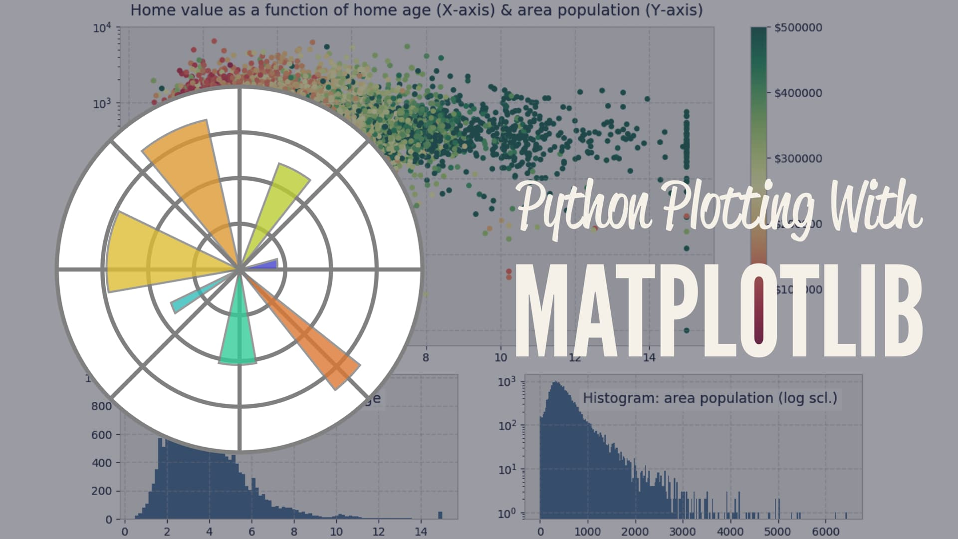
First Steps Continued
There’s a package for basically everything!
Statistical analysis
Graphing
Graphical interfaces, etc.
Example for graphing: Matplotlib
https://matplotlib.org/
Create everything from bar graphs to heat maps
Try looking up something that interests you and see if there’s a Python package for it!

Slide 14

Project-1 Info
Task List:
Read raw_data.csv file
Convert the data to a dataframe
Add a column
Make a graph
Let’s Dive In

Slide 15


Questions?
Contact me
It is my hope that this course is easy to understand and follow
Have a question or want additional details? Just reach out!
If you want to know more about my work (LoL Genius) or have questions about something you’re building, LMK!

